Slide 1
Dynamic memory allocation

Slide 2
Outline
In this lesson, we will:
Revisit static memory allocation (local variables and parameters)
Introduce dynamic memory allocation
Introduce the new and delete operators

Slide 3
Addresses
In this course, you will never need to “know” a specific address
We will call functions or operators that return addresses
Those addresses will then be stored in pointers
We will then access and manipulate what is at that address using the pointers
Thus, never worry about what an address might be
You will only look at addresses if you are debugging your code
Even then, you don’t care about the exact values,
you will simply be comparing the addresses against each other

Slide 4
Static memory allocation
Up to this point, all memory has been in the form of parameters or local variables
The compiler arranges for memory to be allocated when the program executes
Memory is allocated on call stack
When a function exits, the only data that remains are any values that are returned
Such allocation is called static
Arrangements for such memory are made by the compiler
You cannot change how that memory is allocated when the program is executing

Slide 5
Limitations of static memory
Suppose we don’t know how much memory is required?
Consider a text editor: the user could use it to type
a 10-word response, or
a 1000-line program
As the user types more and more characters, how do we keep allocating memory?
All arrays are fixed in capacity, and yet the user can always keep typing no matter how large
There are solutions, but they are awkward to use

Slide 6
Limitations of static memory
Is this a good program for a text editor?
int main();
int main() {
char text[1000000]; // Allocate 1 MB
char[0] = '\0';
// Do something with this character array...
return 0;
}

Slide 7
Limitations of static memory
This is an array is a horrible way of storing a text file:
An e-mail response seldom requires more than 1000 characters
J.R.R. Tolkien just finishes his 500,000 character text “The Hobit”
Fortunately, it fits into our 1 MB file
“The Lord of the Rings” does not…
Suppose he finishes:
"Chapter I\nAN UNEXPECTED PARTY\n\nIn a hole in the
ground there lived a hobbit. Not a nasty, dirty, wet
hole, filled with the ends of worms and an ozy smell,
nor yet a dry, bare, sandy hole with nothing in it to
sit down on or to eat: it was a hobbit-hole, and that
means comfort."

Slide 8
Limitations of static memory
Having finished everything…
He discovers a typo
Changing "ozy" to "oozy" requires that all remaining 499860 characters to be moved one array entry to the right…
Suppose you have a similar document, and you want to make a search-and-replace of all British spellings of works with American spellings…
"Chapter I\nAN UNEXPECTED PARTY\n\nIn a hole in the
ground there lived a hobbit. Not a nasty, dirty, wet
hole, filled with the ends of worms and an ozy smell,
nor yet a dry, bare, sandy hole with nothing in it to
sit down on or to eat: it was a hobbit-hole, and that
means comfort."

Slide 9
Dynamic memory
We need some way of saying:
We need memory, but we have to be able to determine how much memory is needed at run time,
and we have to be able to change it…
Question: Where can we get this memory?
The memory required for a function call is just placed on top memory required for the previous function call
What happens if you need 3 bits, 1 byte, 37 bits, 42 bytes, or 2 400 000 bytes, which is enough for “The Lord of the Rings”?

Slide 10
Dynamic memory
Memory management is an issue dealt with by the operating system
When you execute a program, it is the operating system that allocates the memory for the call stack
If you want memory, you must make a request to the operating system
Question: How do we allow this transaction?
We will ask the operating system for an integral number of bytes
The operating system will then try to find memory to satisfy such a request

Slide 11
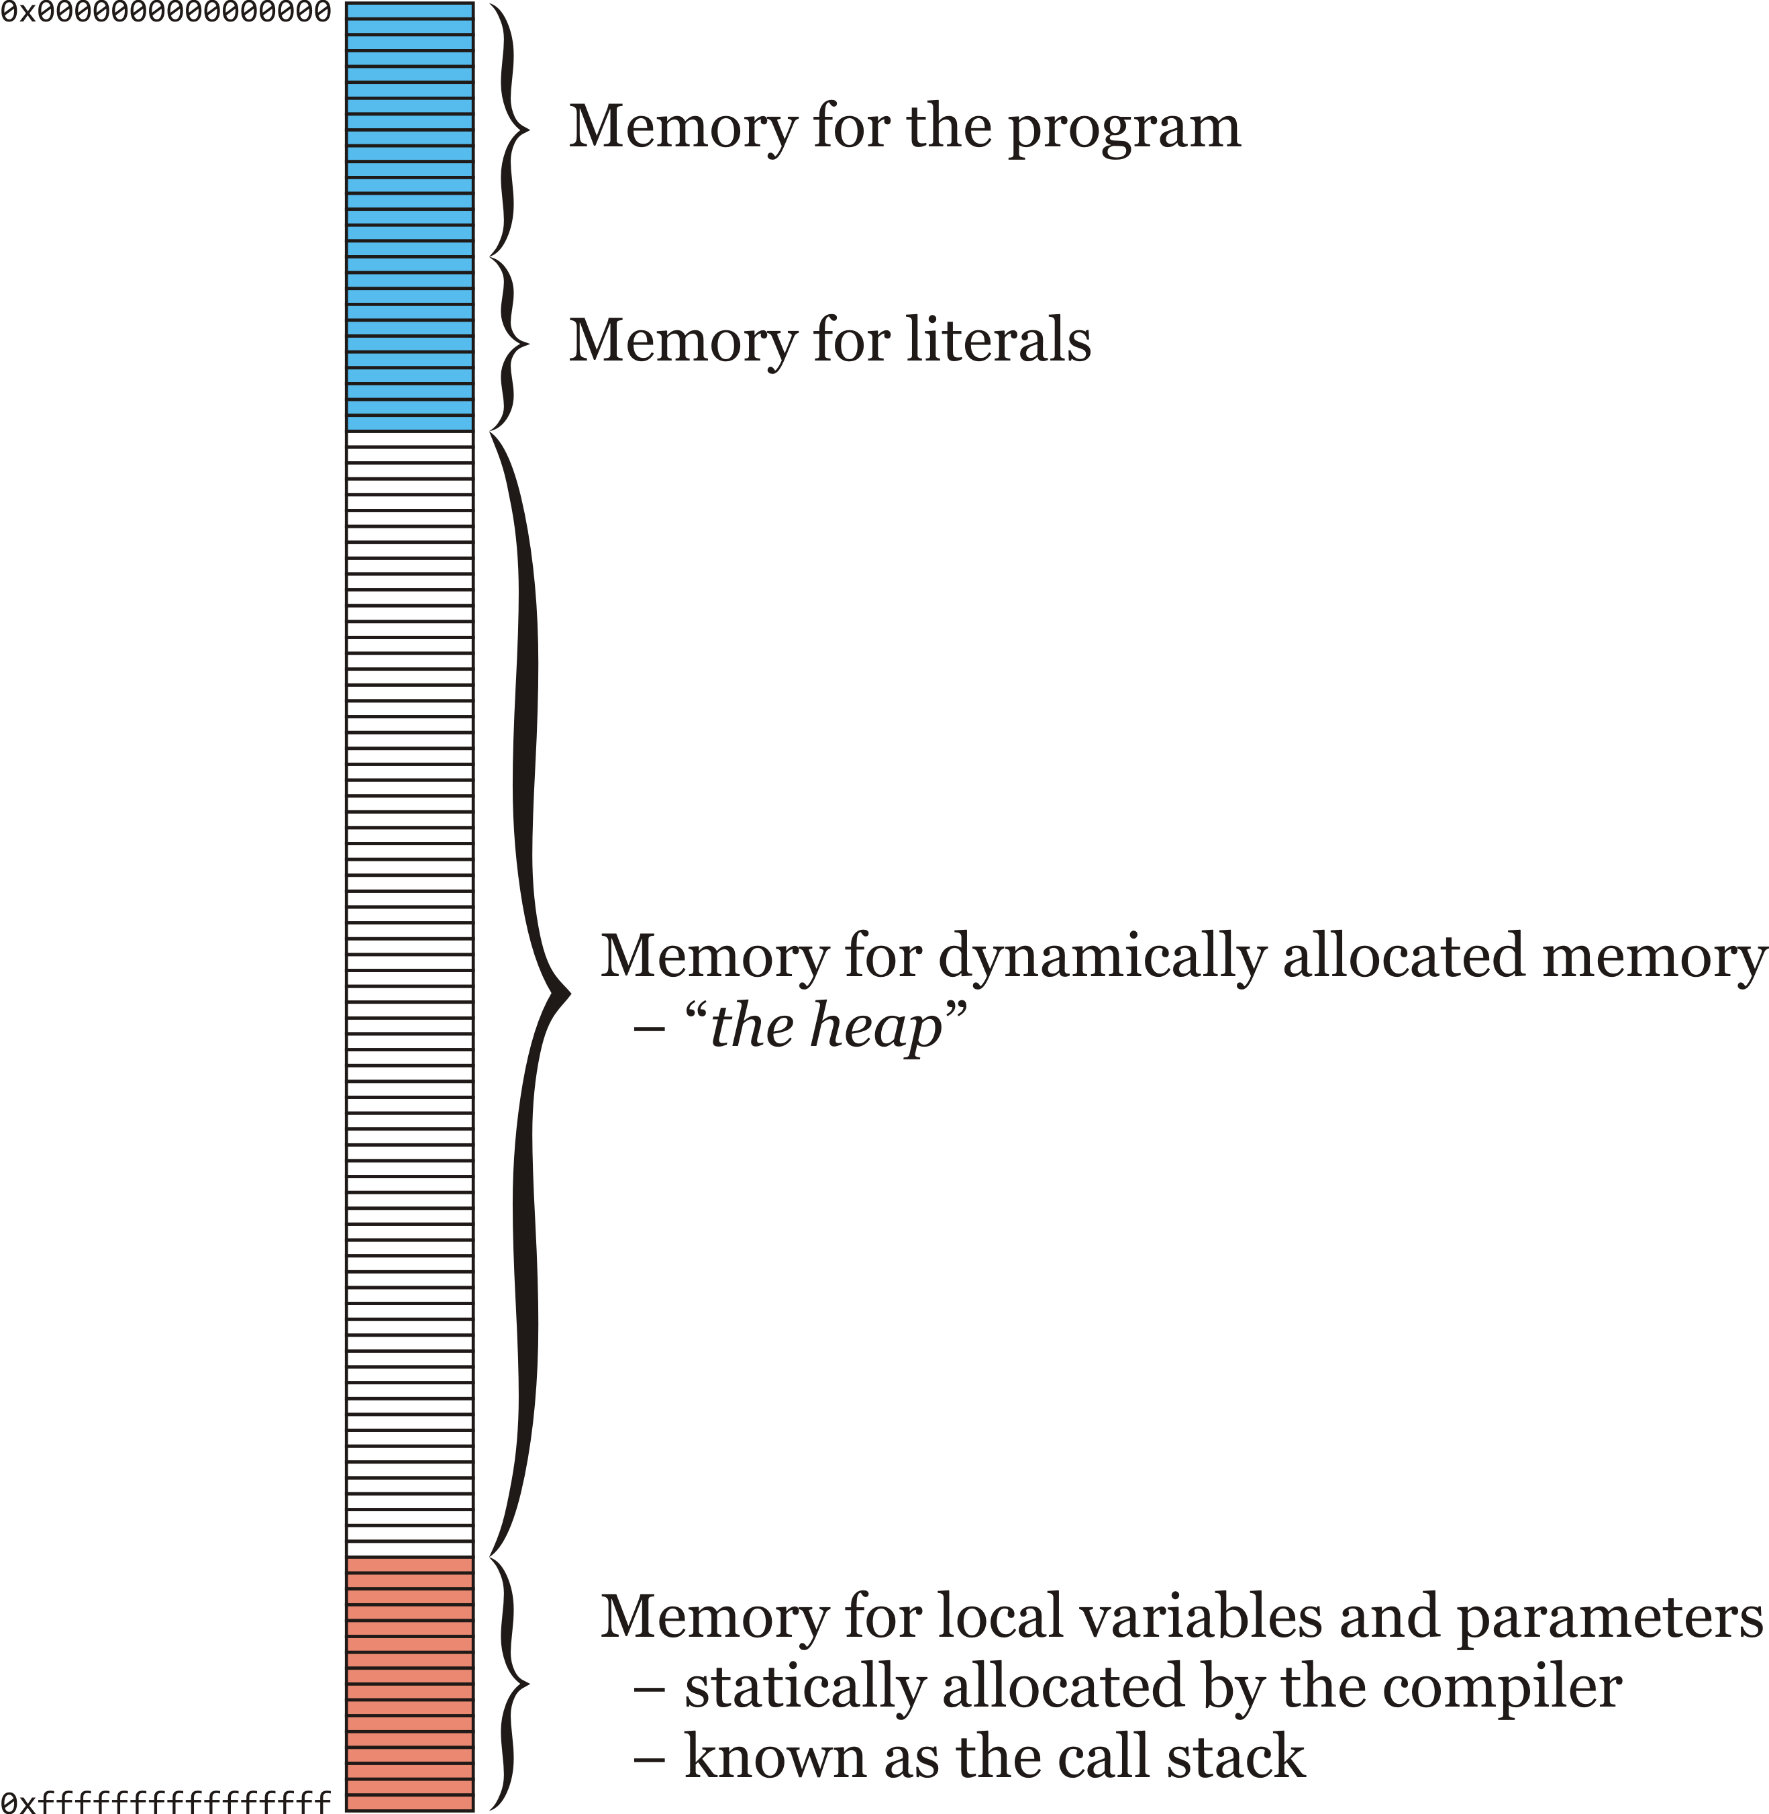
Dynamic memory
Suppose that you ask for 4 bytes:
Some memory is allocated specifically for the program and literals in the program
The call stack is allocated near the end of memory
The compiler determines its use
All other memory may be used for dynamically allocated memory
Also known as the heap

Slide 12
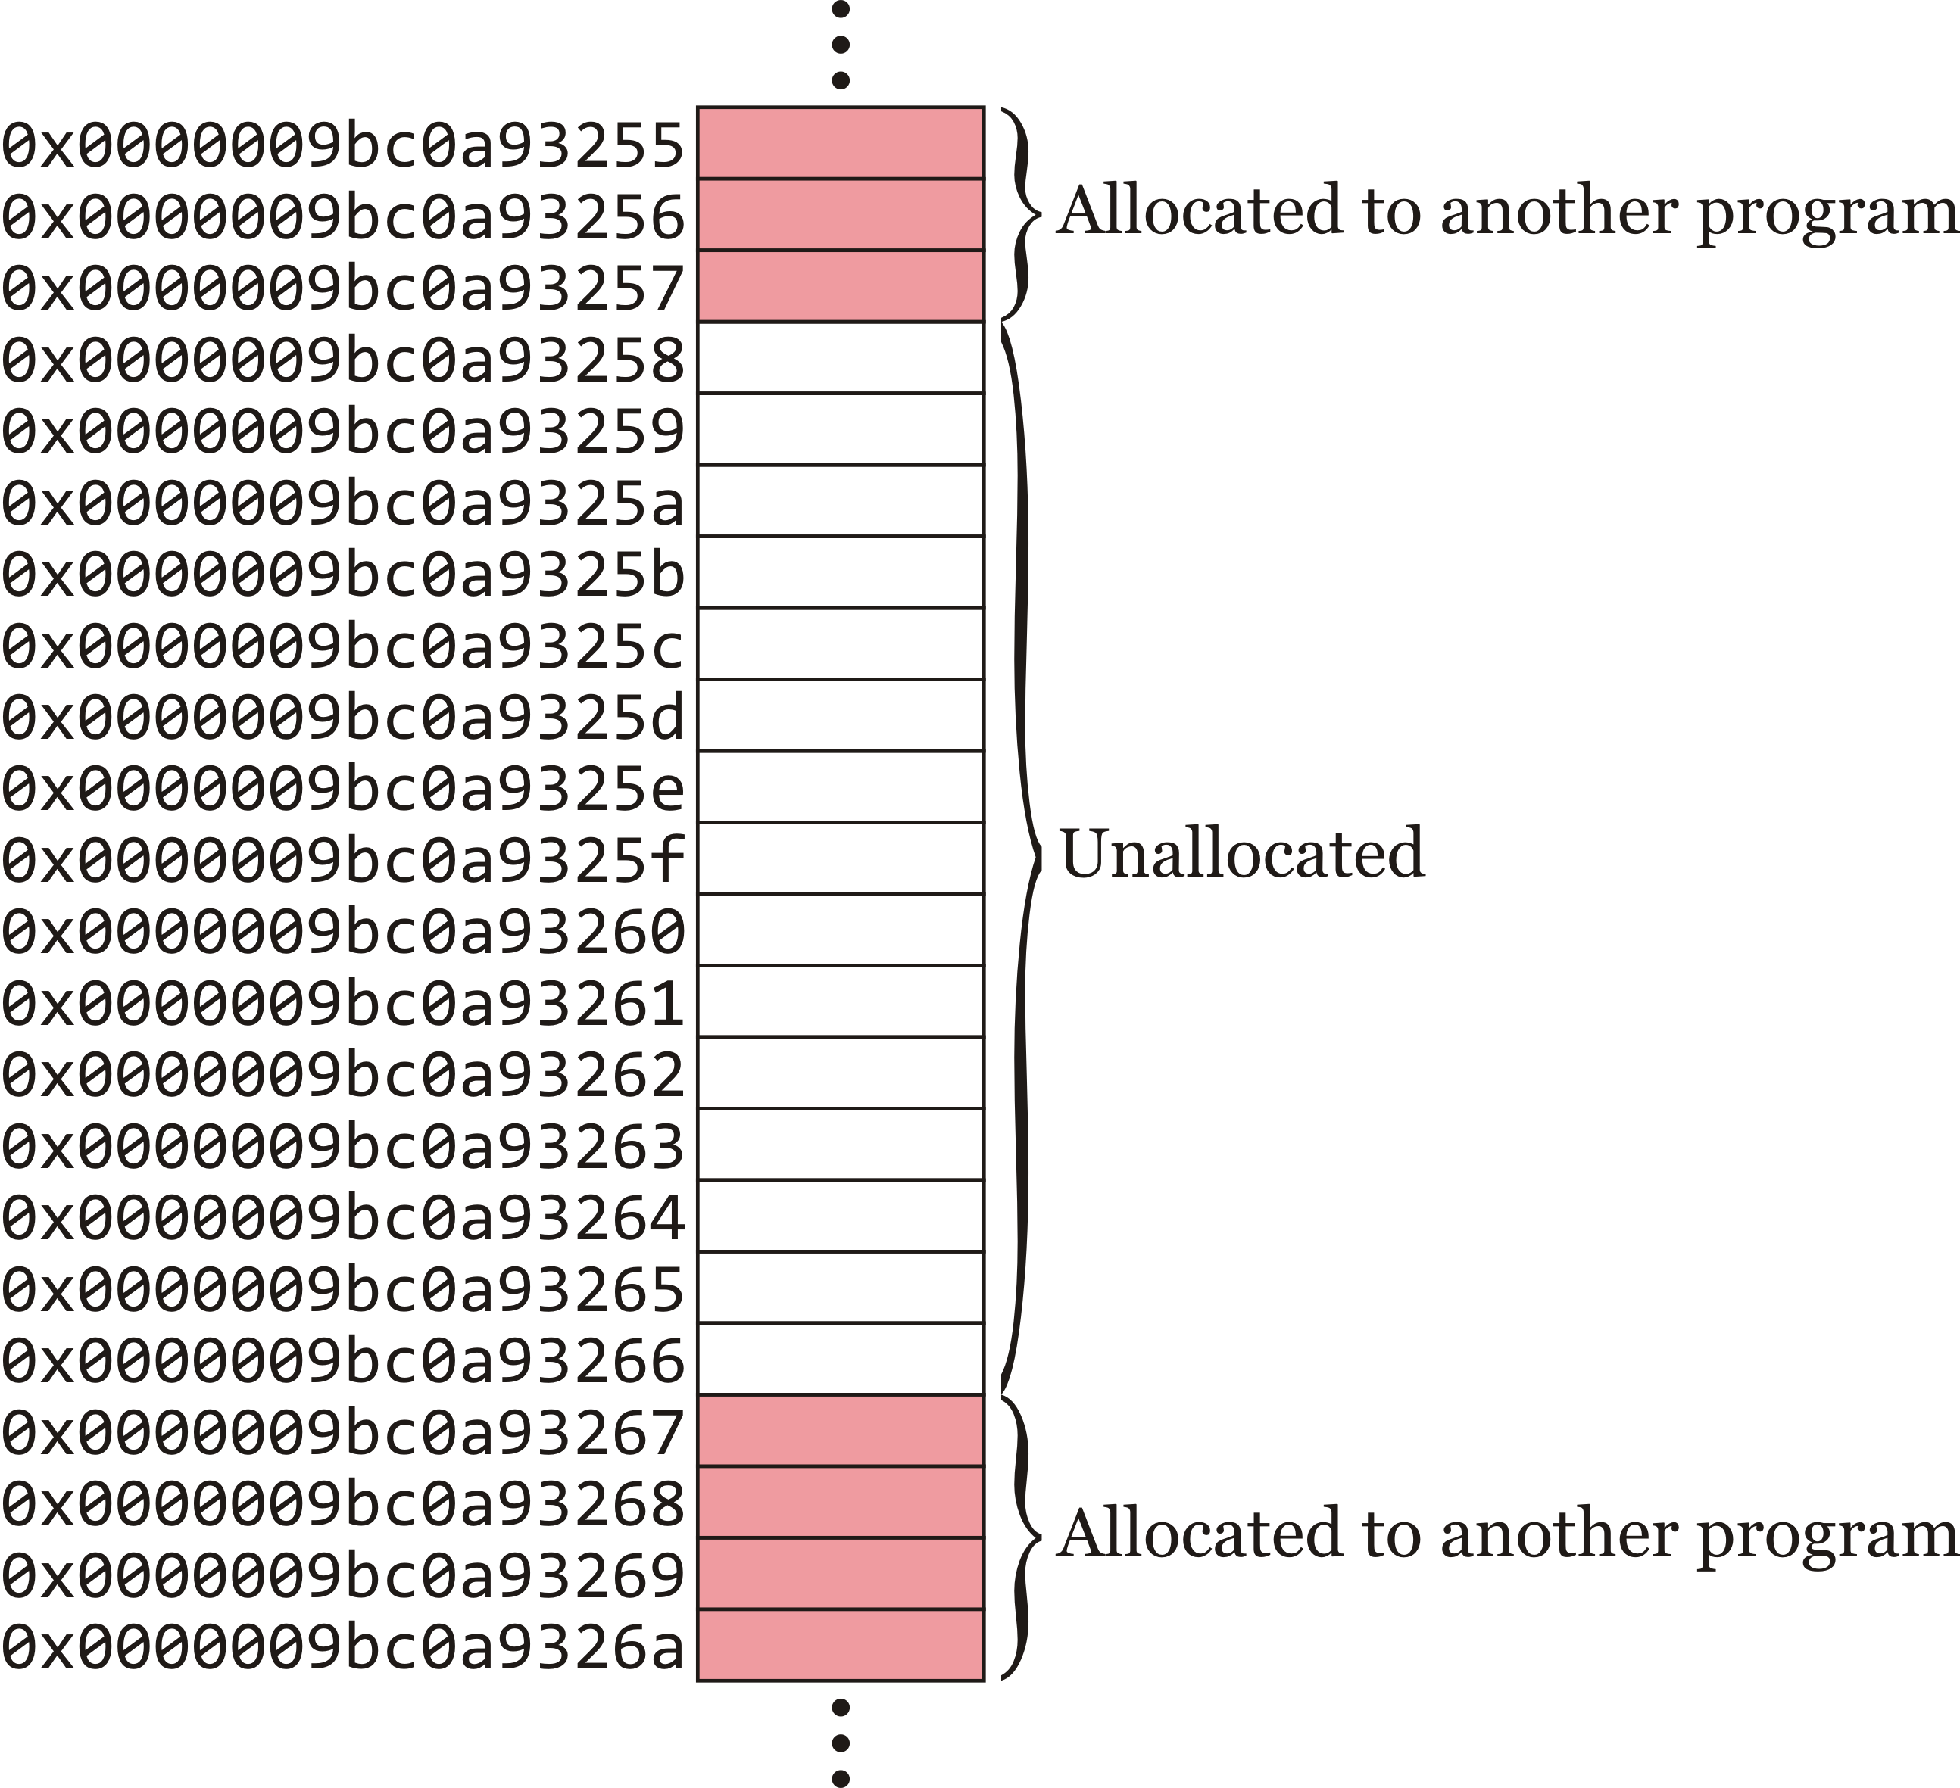
Dynamic memory
Suppose that you ask for 4 bytes:
The operating system finds 4 bytes somewhere in the heap

Slide 13
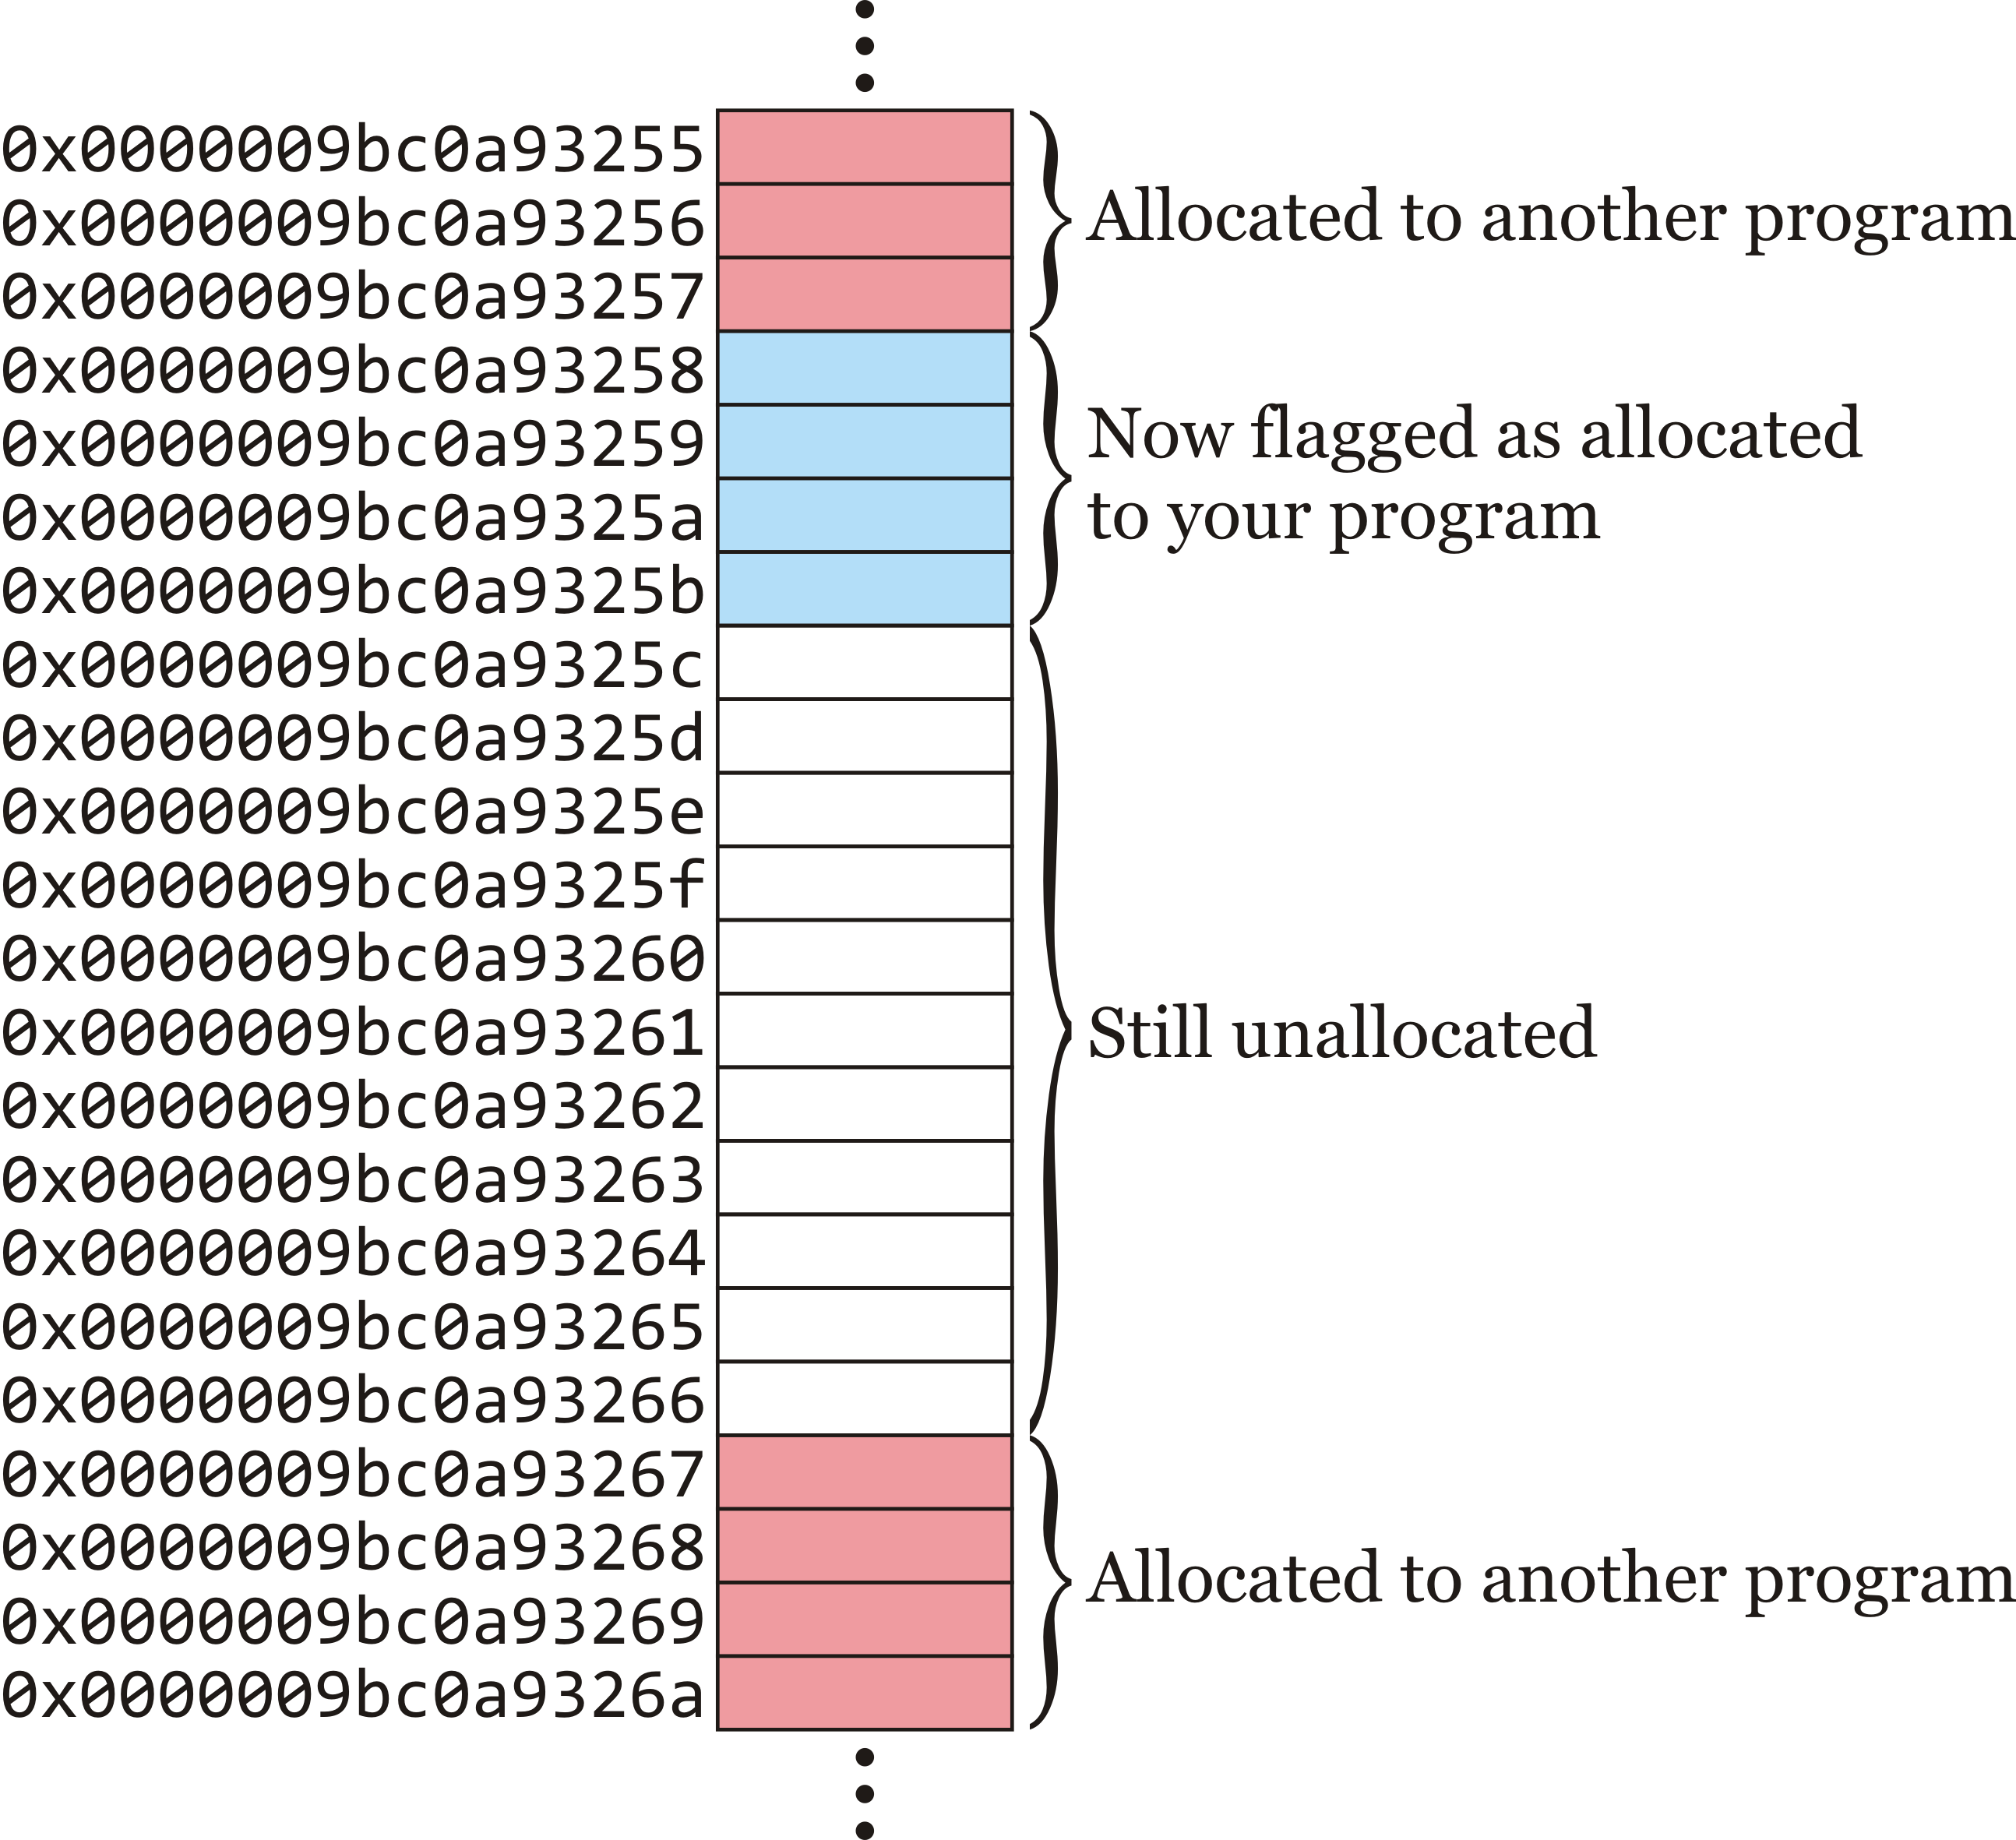
Dynamic memory
The operating system flags these as belonging to your program
There are still 11 bytes left over, perhaps for some other request

Slide 14
Dynamic memory
How can you access this memory?
How does the operating system tell you that these 4 bytes are yours to use?

Slide 15
Dynamic memory
A common solution is to return the address:
“Your 4 bytes are at memory location 0x000009bc0a93258”

Slide 16
Dynamic memory
The operating system could return this address, and we can assign this address to a pointer
Question: how many bytes do you need?
You could calculate it, but…C++ makes it easier
The compiler does the work

Slide 17
The new operator
The keyword new defines a unary operator in C++:
It takes a type as an operand
Optionally, you can give the item an initial value
It requests sufficient memory from the operating system for the type
It returns the address supplied by the operating system
int main() {
// p_int is a local variable capable of
// storing an address
int *p_int{};
p_int = new int{ 42 };
std::cout << p_int << std::endl;
return 0;
}

Slide 18
The new operator
Let’s see what happens:
int main() {
// p_int is a local variable capable of
// storing an address
int *p_int{};
p_int = new int{42};
std::cout << p_int << std::endl;
return 0;
}
p_int is a local variable
– It occupies 8 bytes on the stack
– It is initialized with 0x000…000
 | ⋮
0x0000009bc0a93257 |  | Allocated to another executing program
0x0000009bc0a93258
0x0000009bc0a93259
0x0000009bc0a9325a
0x0000009bc0a9325b
0x0000009bc0a9325c
 | ⋮

Slide 19
The new operator
Let’s see what happens:
int main() {
// p_int is a local variable capable of
// storing an address
int *p_int{};
p_int = new int{42};
std::cout << p_int << std::endl;
return 0;
}
The compiler knows an int is 4 bytes
– Behind the scene, a system call is made requesting 4 bytes
 | ⋮
0x0000009bc0a93257
0x0000009bc0a93258
0x0000009bc0a93259
0x0000009bc0a9325a
0x0000009bc0a9325b
0x0000009bc0a9325c
 | ⋮

Slide 20
The new operator
Let’s see what happens:
int main() {
// p_int is a local variable capable of
// storing an address
int *p_int{};
p_int = new int{42};
std::cout << p_int << std::endl;
return 0;
}
The operating system finds 4 bytes and
flags it as allocated to your program
– It returns 0x9bc0a93258
 | ⋮
0x0000009bc0a93257
0x0000009bc0a93258 |  | Allocated to your executing program
0x0000009bc0a93259
0x0000009bc0a9325a
0x0000009bc0a9325b
0x0000009bc0a9325c
 | ⋮

Slide 21
The new operator
Let’s see what happens:
int main() {
// p_int is a local variable capable of
// storing an address
int *p_int{};
p_int = new int{42};
std::cout << p_int << std::endl;
return 0;
}
The new operator now initializes
that memory with the value 42
 | ⋮
0x0000009bc0a93257
0x0000009bc0a93258 | 00000000 | Allocated to your executing program
0x0000009bc0a93259 | 00000000
0x0000009bc0a9325a | 00000000
0x0000009bc0a9325b | 00101010
0x0000009bc0a9325c
 | ⋮

Slide 22
The new operator
Let’s see what happens:
int main() {
// p_int is a local variable capable of
// storing an address
int *p_int{};
p_int = new int{42};
std::cout << p_int << std::endl;
return 0;
}
The value 0x9bc0a93258 is assigned
to the local variable 'p_int'
 | ⋮
0x0000009bc0a93257
0x0000009bc0a93258 | 00000000 | Allocated to your executing program
0x0000009bc0a93259 | 00000000
0x0000009bc0a9325a | 00000000
0x0000009bc0a9325b | 00101010
0x0000009bc0a9325c
 | ⋮

Slide 23
The new operator
Let’s see what happens:
int main() {
// p_int is a local variable capable of
// storing an address
int *p_int{};
p_int = new int{42};
std::cout << p_int << std::endl;
return 0;
}
The value 0x9bc0a93258 is printed to the console
 | ⋮
0x0000009bc0a93257
0x0000009bc0a93258 | 00000000 | Allocated to your executing program
0x0000009bc0a93259 | 00000000
0x0000009bc0a9325a | 00000000
0x0000009bc0a9325b | 00101010
0x0000009bc0a9325c
 | ⋮

Slide 24
The new operator
Let’s see what happens:
int main() {
// p_int is a local variable capable of
// storing an address
int *p_int{};
p_int = new int{42};
std::cout << p_int << std::endl;
return 0;
}
Your program exits
 | ⋮
0x0000009bc0a93257
0x0000009bc0a93258 | 00000000 | Allocated to your executing program
0x0000009bc0a93259 | 00000000
0x0000009bc0a9325a | 00000000
0x0000009bc0a9325b | 00101010
0x0000009bc0a9325c
 | ⋮

Slide 25
The new operator
Let’s see what happens:
int main() {
// p_int is a local variable capable of
// storing an address
int *p_int{};
p_int = new int{42};
std::cout << p_int << std::endl;
return 0;
}
The operating system realizes you have some
memory allocated, so it flags it as unallocated
– The memory still stores the value 42
 | ⋮
0x0000009bc0a93257
0x0000009bc0a93258 | 00000000 | Now available again for another request
0x0000009bc0a93259 | 00000000
0x0000009bc0a9325a | 00000000
0x0000009bc0a9325b | 00101010
0x0000009bc0a9325c
 | ⋮

Slide 26
The new operator
We can even initialize the pointer if appropriate:
int main() {
// p_int is a local variable capable of
// storing an address
int *p_int{ new int{42} };
std::cout << p_int << std::endl;
return 0;
}

Slide 27
Using the allocated memory
Let’s now use this memory
int main() {
// p_int is a local variable capable of
// storing an address
int *p_int{ new int{42} };
std::cout << p_int << std::endl;
std::cout << *p_int << std::endl;
*p_int = 91;
std::cout << *p_int << std::endl;
return 0;
}

Slide 28
Using the allocated memory
Let’s now use this memory
int main() {
// p_int is a local variable capable of
// storing an address
int *p_int{ new int{42} };
std::cout << p_int << std::endl;
std::cout << *p_int << std::endl;
*p_int = 91;
std::cout << *p_int << std::endl;
return 0;
}
Output:
0x9bc0a93258
42
 | ⋮
0x0000009bc0a93257
0x0000009bc0a93258 | 00000000 | Allocated to your executing program
0x0000009bc0a93259 | 00000000
0x0000009bc0a9325a | 00000000
0x0000009bc0a9325b | 00101010
0x0000009bc0a9325c
 | ⋮

Slide 29
Using the allocated memory
Let’s now use this memory
int main() {
// p_int is a local variable capable of
// storing an address
int *p_int{ new int{42} };
std::cout << p_int << std::endl;
std::cout << *p_int << std::endl;
*p_int = 91;
std::cout << *p_int << std::endl;
return 0;
}
Output:
0x9bc0a93258
42
 | ⋮
0x0000009bc0a93257
0x0000009bc0a93258 | 00000000 | Allocated to your executing program
0x0000009bc0a93259 | 00000000
0x0000009bc0a9325a | 00000000
0x0000009bc0a9325b | 01011011
0x0000009bc0a9325c
 | ⋮

Slide 30
Using the allocated memory
Let’s now use this memory
int main() {
// p_int is a local variable capable of
// storing an address
int *p_int{ new int{42} };
std::cout << p_int << std::endl;
std::cout << *p_int << std::endl;
*p_int = 91;
std::cout << *p_int << std::endl;
return 0;
}
Output:
0x9bc0a93258
42
91
 | ⋮
0x0000009bc0a93257
0x0000009bc0a93258 | 00000000 | Allocated to your executing program
0x0000009bc0a93259 | 00000000
0x0000009bc0a9325a | 00000000
0x0000009bc0a9325b | 01011011
0x0000009bc0a9325c
 | ⋮

Slide 31
The new operator
Note that the operating system cleans up your mess after your program exits
Is this a good idea?
Suppose you open a tab on your web browser
That tab requires memory to be dynamically allocated
A lot of memory if it is, for example, YouTube
Suppose you now close that tab…
Is it necessary that that memory remain allocated to the browser?

Slide 32
The delete operator
Just like programs can request memory, programs are able to explicitly tell the operating system when that memory is no longer needed
int main() {
// p_int is a local variable capable of
// storing an address
int *p_int{};
p_int = new int{42};
std::cout << p_int << std::endl;
delete p_int;
p_int = nullptr;
return 0;
}
The address stored in p_int
is sent to the operating system
Next, we want to forget this address,
so we set p_int to the zero address

Slide 33
The delete operator
The delete operator simply sends the address to the operating system, which then flags that memory as no longer allocated to your program
You, however, through 'p_int' are still aware of that address
int main() {
int *p_int{new int{42}};
std::cout << p_int << std::endl;
delete p_int;
std::cout << p_int << std::endl;
p_int = nullptr;
std::cout << p_int << std::endl;
return 0;
}
Output:
0x12cb010
0x12cb010
0x0

Slide 34
Looking ahead
There are many possible issues with pointers and dynamic memory allocation
This issues cause fear for many students
Over the next few lectures, we will address a few of this issues
Hopefully, these will give you the confidence necessary to understand this fundamental aspect of programming

Slide 35
Summary
Following this lesson, you now
Understand the limitations of local variables
Know that memory can be allocated at run time
Known as dynamic memory allocation
Are familiar with the new and delete operators for allocation memory

Slide 36
References
[1] https://en.wikipedia.org/wiki/Pointer_(computer_programming)

Slide 37
Colophon
These slides were prepared using the Georgia typeface. Mathematical equations use Times New Roman, and source code is presented using Consolas.
The photographs of lilacs in bloom appearing on the title slide and accenting the top of each other slide were taken at the Royal Botanical Gardens on May 27, 2018 by Douglas Wilhelm Harder. Please see
https://www.rbg.ca/
for more information.

Slide 38
Disclaimer
These slides are provided for the ece 150 Fundamentals of Programming course taught at the University of Waterloo. The material in it reflects the authors’ best judgment in light of the information available to them at the time of preparation. Any reliance on these course slides by any party for any other purpose are the responsibility of such parties. The authors accept no responsibility for damages, if any, suffered by any party as a result of decisions made or actions based on these course slides for any other purpose than that for which it was intended.

